Slide 1
eDiscovery – A Vancouver Litigator’s Perspective Webinar Presentation to Association of Certified E-Discovery Specialists (AECDS), Vancouver Chapter
Andrew I. Nathanson
Fasken Martineau DuMoulin LLP
September 1, 2020

Slide 2
Introduction: an object lesson

Slide 3
What occupies counsel?
Winning cases and looking good
In particular:
Early case assessment
Sound project management
Sound project management engenders client loyalty and wins repeat business
Poor project management dims the lustre of even the most brilliant counsel work

Slide 4
What occupies counsel? (cont.)
Also:
Finding the right documents
Controlling costs and data volumes
Winning at discovery motions
Proportionality and reciprocity

Slide 5
Taking it to the next level
Get on the team and become a trusted advisor
Understand:
How litigation really works
The goals and strategy of this litigation
Insist on helping shape the discovery strategy

Slide 6
Taking it to the next level (cont.)
Don’t just swim with the data tide
Seek quality over quantity
Promote competency, standards and a culture of collaboration among the e-discovery community
Educate counsel on the forensic possibilities of e-discovery
Manage the project like an owner

Slide 7
Discussion and Conclusion

Slide 8
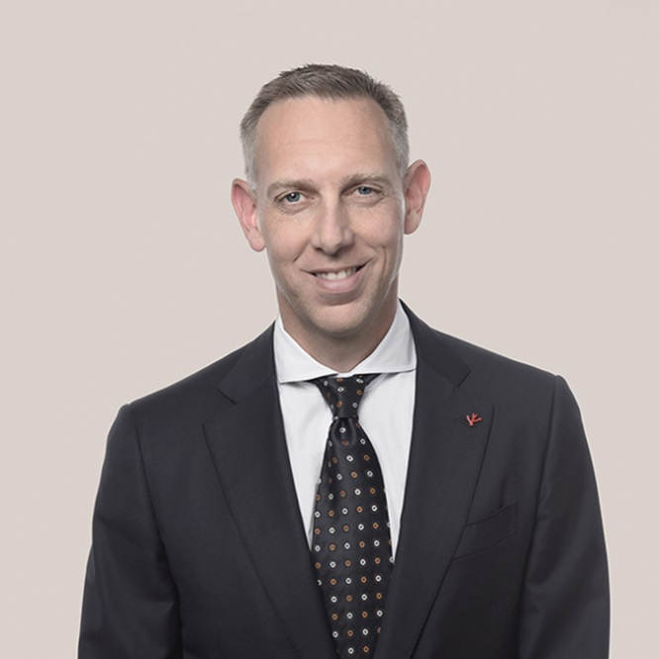
Andrew Nathanson
Partner
+1 604 631 4908
anathanson@fasken.com

